Slide 1
UPEC: A Multi-Modal AI-Powered Device for Portable ECG, PCG, and PPG Cardiac Diagnostics
Group Members:
Khair Ul Wara (36443)
Rana Talha Khalid (39220)
Muhammad Hasan Masrur (37112)
Abdul Alber (31600)
Supervisor:
Dr. Jawad Hussain

Slide 2
Individual Contribution
Khair Ul Wara: Enclosure prototyping Component Selection Circuit Design Sensor integration
Rana Talha Khalid: Microcontroller programming PTB-XL/MIMIC dataset fine-tuning Model Design App Design
Muhammad Hasan Masrur Signal preprocessing Implementing hybrid CNN Transformer and CNN-LSTM (PCG) models Model testing Clinical Liaison & Validation Coordinator
Abdul Alber: Clinical testing protocol Statistical report generation Documentation Supply Chain Manager

Slide 3
Introduction
Cardiovascular diseases are the leading cause of death globally, responsible for 32% of all deaths worldwide, with cardiovascular conditions alone contributing to 17.9 million deaths annually. In our society, this burden is even higher due to inadequate access to timely diagnosis and care, procedural inefficiencies, and the cost of checkups/treatment, resulting in delayed action and poor outcomes. To address these inefficiencies, we propose a device capable of real-time, AI-powered monitoring of cardiorespiratory systems using Electrocardiography (ECG), Phonocardiography (PCG), and Photoplethysmography (PPG), offering early diagnosis of various diseases. Moreover, a portable handheld ultrasound imaging system is also integrated into this proposed system, offering immediate structural investigative capabilities if required.

Slide 4
Problem Statement
Over 500 million people worldwide suffer from cardiovascular diseases.
In 2021, cardiovascular diseases caused 20.5 million deaths.
Time-consuming due to multiple tests and appointments.

Slide 5
Problem Statement
Delays diagnosis and increases healthcare costs.
Real-time monitoring and analysis are often unavailable, especially in resource-limited settings.
Lack of cross-relational and cross-functional analysis between ECG, PCG, and PPG.
Manual interpretation introduces variability and potential inaccuracies.

Slide 6
Literature Study / Data Collection
Bio signal | Methodology | Key findings | Reference
ECG | 23-Layer Hybrid CNN-LSTM Model Classification Accuracy: CNN: 99.82%, CNN-LSTM: 99.88%, Ensemble: 99.89% | SMOTE-Tomek solves imbalanced data Significantly improves minority class detection. CNN-LSTM captures temporal ECG patterns Hybrid structure enhances MI identification accuracy. | [1]
ECG | 5 layer1D CNN layers for feature extraction combined with 1 LSTM Layer achieving 98.22% accuracy with a sensitivity of 98.23% and specificity of 99.64%. | The hybrid CNN-LSTM model uses 64,034 parameters, significantly reducing computational complexity, and using ECG beats in 2.987 ms, making it suitable for real-time applications in clinical settings and embedded systems. Effective up-sampling improves detection of rare ECG types, ensuring robust classification across six ECG beat categories​ | [2]

Slide 7
Literature Study
Bio signal | Methodology | Key findings | Reference
PCG | ResNet50 for feature extraction combined with a Transformer Encoder, enhanced by Multiple Layer Perceptron (MLP) layers, Achieves 99.80% accuracy on the Yaseen dataset and 97.40% accuracy on the PhysioNet 2016 dataset. | MFCC extraction yields optimal feature representations. Incorporation of DWT features may further enhance performance. Hybrid models outperform standalone AI models for both multiclass and binary classifications | [3]
ECG | ESN-based reservoir computing model, using cyclic reservoir connection, Achieves 98.98% accuracy on the modified lead II (MLII) and 97.95% accuracy on the V1 lead. | Cyclic ESN model reduces computational cost and enables efficient real-time classification. The approach is claimed to be scalable and energy-efficient, making it suitable for deployment in wearable Medical Internet of Things (MIoT) devices, | [4]

Slide 8
Literature Study
ECG, SCG | Flexible wearable sensors utilizing MXene, graphene, and polydimethylsiloxane (PDMS) were integrated with IoT and edge computing to monitor cardiovascular disease through multi-modal signals (pulse wave, ECG, SCG), achieving high sensitivity (up to 924.37 kPa⁻¹) and enabling future work on signal optimization and noise reduction | The study achieved 99% signal accuracy in detecting pulse wave and ECG events through the integration of highly sensitive (924.37 kPa⁻¹) MXene and PDMS-based sensors, demonstrating a 30% improvement in real-time cardiovascular diagnostics, particularly in arterial stiffness and cardiac output measurements, with noise reduction optimization as a critical next step for enhancing multi-signal fidelity | [5]
ECG, PCG, Body Temperature | Developed a low-cost simultaneous acquisition system for ECG, PCG, and body temperature signals using INA128P instrumentation amplifiers for ECG, electret microphones for PCG Data acquisition was conducted via the NI USB 6009. | The ECG amplifier achieved a practical gain of 2440 V/V with 2.4% error, and the PCG amplifier realized a gain of 372400 V/V with 18.87% error. Future improvements will focus on increasing the integration of telemedicine applications and expanding diagnostic capabilities​ | [6]

Slide 9
PTB-XL Dataset
Large Clinical ECG Dataset: PTB-XL comprises 21,799 clinical 12-lead ECG records (10 seconds each) from 18,869 patients, with demographic diversity (ages 0–95, 52% male/48% female) and annotations for pathologies like myocardial infarction (MI), conduction disturbances (CD), and normal rhythms (NORM).
Rich Annotations & Metadata: Each record includes cardiologist-validated diagnostic statements (71 SCP-ECG standard labels), signal quality metrics, patient metadata, and recommended 10-fold train-test splits for machine learning benchmarking.
Open Access & Formats: Data is stored in WFDB format at 500 Hz (and downsampled 100 Hz versions), released under CC-BY 4.0 license for research, supporting AI-driven ECG analysis with standardized citations and preprocessing scripts.
Only Lead I was used and RR interval mean, ST elevation, PR and PQ intervals, QRS duration, QT interval, and P, Q, and R wave amplitudes from the ECG waveforms were selected to train the model.

Slide 10
CIRCOR DIGISCOPE:
Pediatric Heart Sound Database: Contains 5,282 phonocardiogram (PCG) recordings from 1,568 patients, captured at four auscultation points (aortic, pulmonic, tricuspid, mitral) with an average length of 23 seconds.
Rich Murmur Annotations: Features semi-supervised annotations (validated by cardiac physiologists) detailing murmur characteristics: timing (systolic/diastolic), shape (crescendo, plateau), pitch (high/medium/low), Levine grading, and quality (blowing/harsh), stored in structured CSV metadata.
Open Access for AI Research: Released under ODC-By 1.0 license with WAV-format recordings, segmentation files, and train-test splits (30% public in v1.0.0), supporting development of automated murmur detection/classification algorithms in real-world noisy environments.

Slide 11
Timeline
Activity | October-Nov 2024 |  | Dec-24 | Jan-25 | Feb-25 | March 25 | April-May 25
Collection of Literature | ✔ | ✔
Study of Literature |  | ✔
Analysis of Proposed Scheme |  |  | ✔
Preparation of Schemes / Model |  |  |  | ✔
Implementation of Schemes/Model |  |  |  |  | ✔ | ✔
Analysis & Simulation |  |  |  |  |  |  | ✔
Result Formulation |  |  |  |  |  |  | ✔ | ✔
Final Write-up & FYP Report Submission |  |  |  |  |  |  |  | ✔
Notes:
Use sign  for the activity which is completed and sign  which is remaining

Slide 12
Methodology
Multi-Modal Integration Combined ECG (Lead I), PCG, and PPG sensing in a handheld wireless device.
AI-Driven Analysis
ECG: CNN-Transformer hybrid (PTB-XL dataset) for 5-class cardiac diagnosis
PCG: CNN-BiLSTM with STFT/MFCC features for murmur detection
PPG: HHT-enhanced CNN (MIMIC dataset) for cuffless BP estimation
Robust Validation Trained on 20k+ clinical recordings with class-balancing and augmentation.
Real-Time Processing On-device AI inference with <1s latency for immediate diagnostics.

Slide 13
Methodology
Pre-Processing: Bandpass filtering (PCG), cycle segmentation (Hilbert transform), time-frequency transforms (STFT)
AI Models: CNN-Transformer for ECG, CNN-LSTM for PCG and CNN for Blood Pressure.
User Interface: Output on a user-friendly app for the healthcare workers.

Slide 14
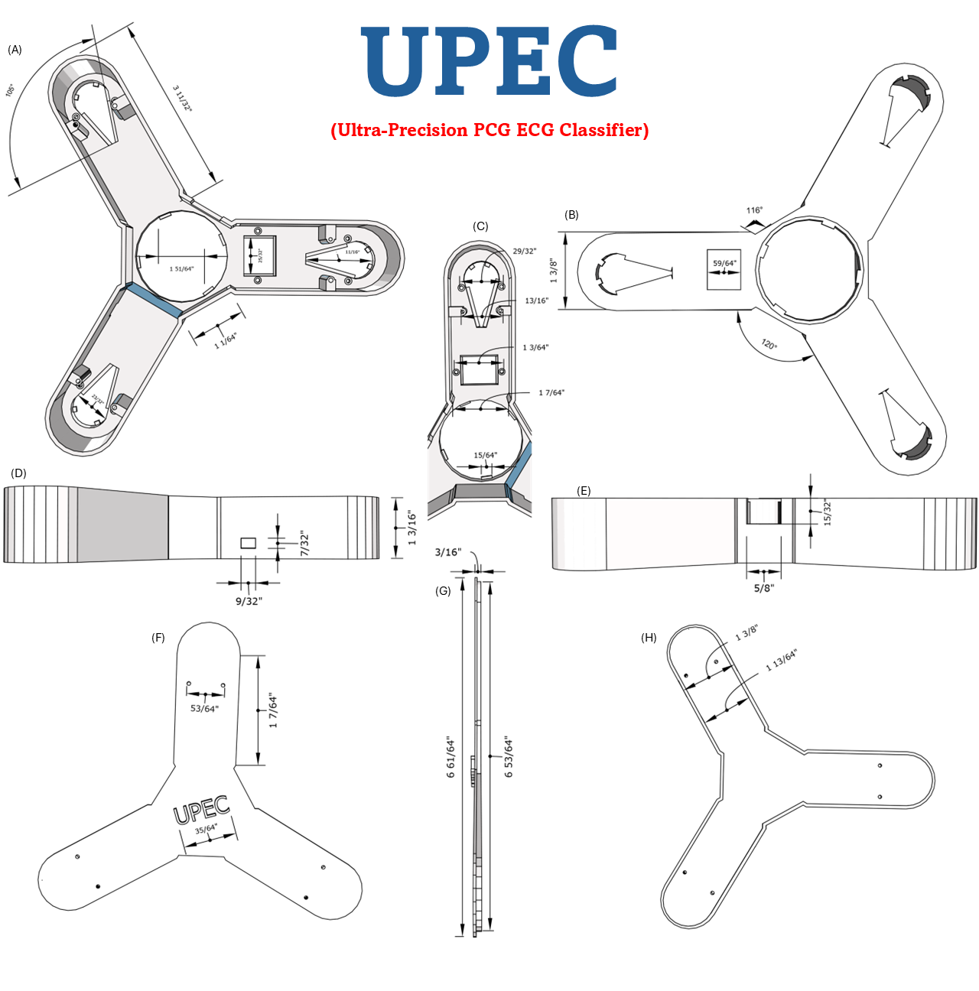
Methodology: CAD Design

Slide 15
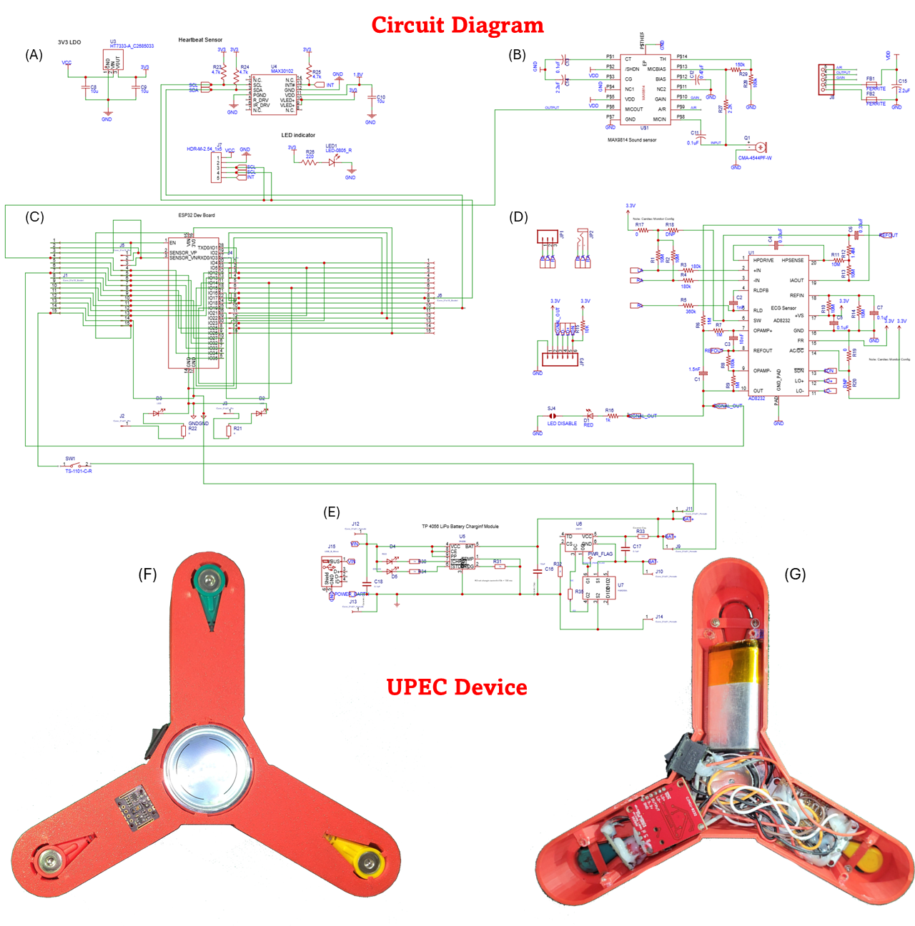
Methodology: Circuit Diagram

Slide 16
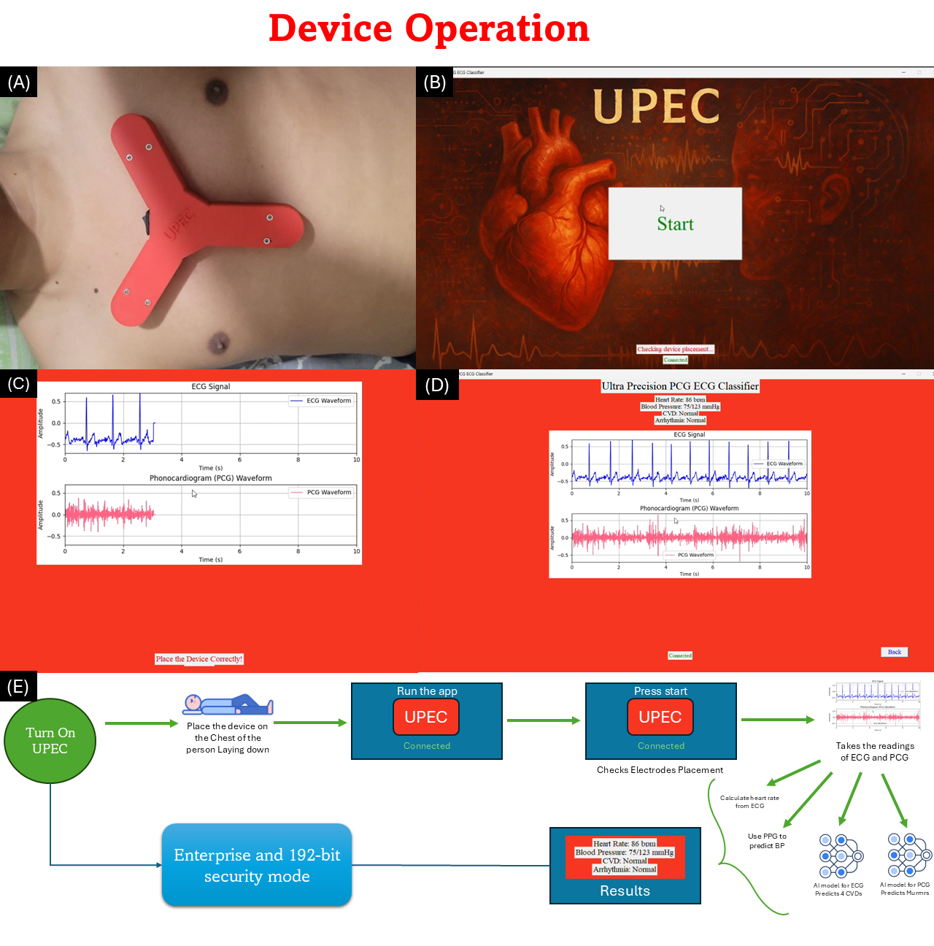
Block Diagram of Proposed work

Slide 17
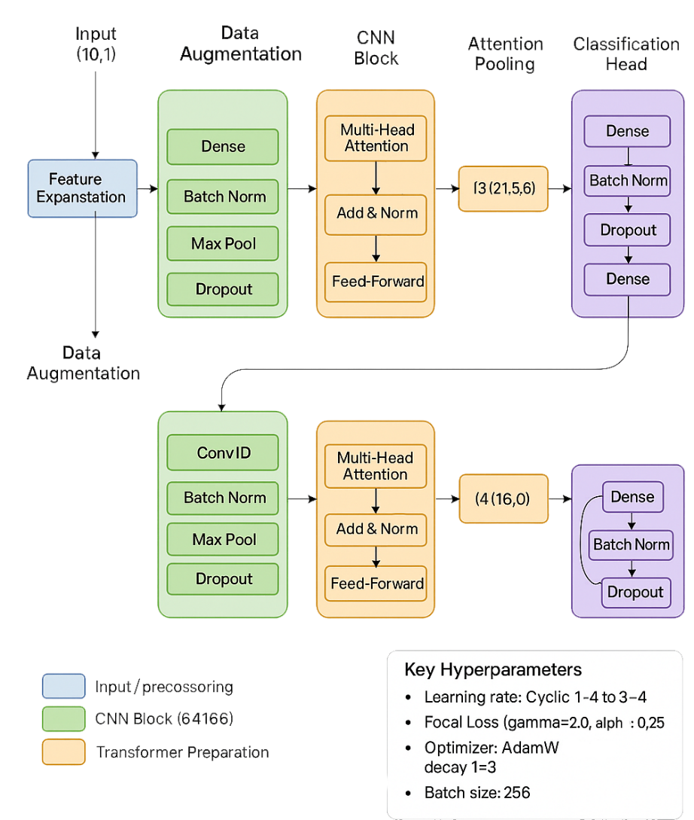
ECG Model: CNN Transformer
CNN Layers with Residual Connections: The model employs 4 CNN layers (filters up to 665, GELU activation, L2 regularization) to extract local spatial features from 10 ECG features (e.g., RR_Mean_Global, ST_Elev_I). Residual connections in the CNN block enhance gradient flow, prevent vanishing gradients, and enable deeper networks by preserving information across layers, improving training stability and convergence.
Transformer Blocks for Temporal Dependencies: Eight Transformer blocks (332 embed_dim, 10 heads, 665 feed-forward dim) capture long-range temporal dependencies in ECG signals, allowing the model to effectively model complex patterns critical for distinguishing the 5 diagnostic classes (NORM, MI, STTC, CD, HYP).
Attention Pooling and Data Augmentation: Attention pooling aggregates key features by weighting their importance, refining classification focus, while data augmentation (random scaling and Gaussian noise) enhances robustness to signal variations, improving generalization across diverse ECG data.
Optimized Training and Evaluation: The model uses FocalLoss (gamma=2.0, alpha=0.25) to address class imbalance, a cyclic learning rate schedule (1e-4 to 3e-4) with AdamW for adaptive optimization, 5-fold cross-validation, early stopping (patience=30), and checkpointing to select the best model by validation accuracy, with test-time augmentation (TTA) boosting test performance through averaged predictions.

Slide 18
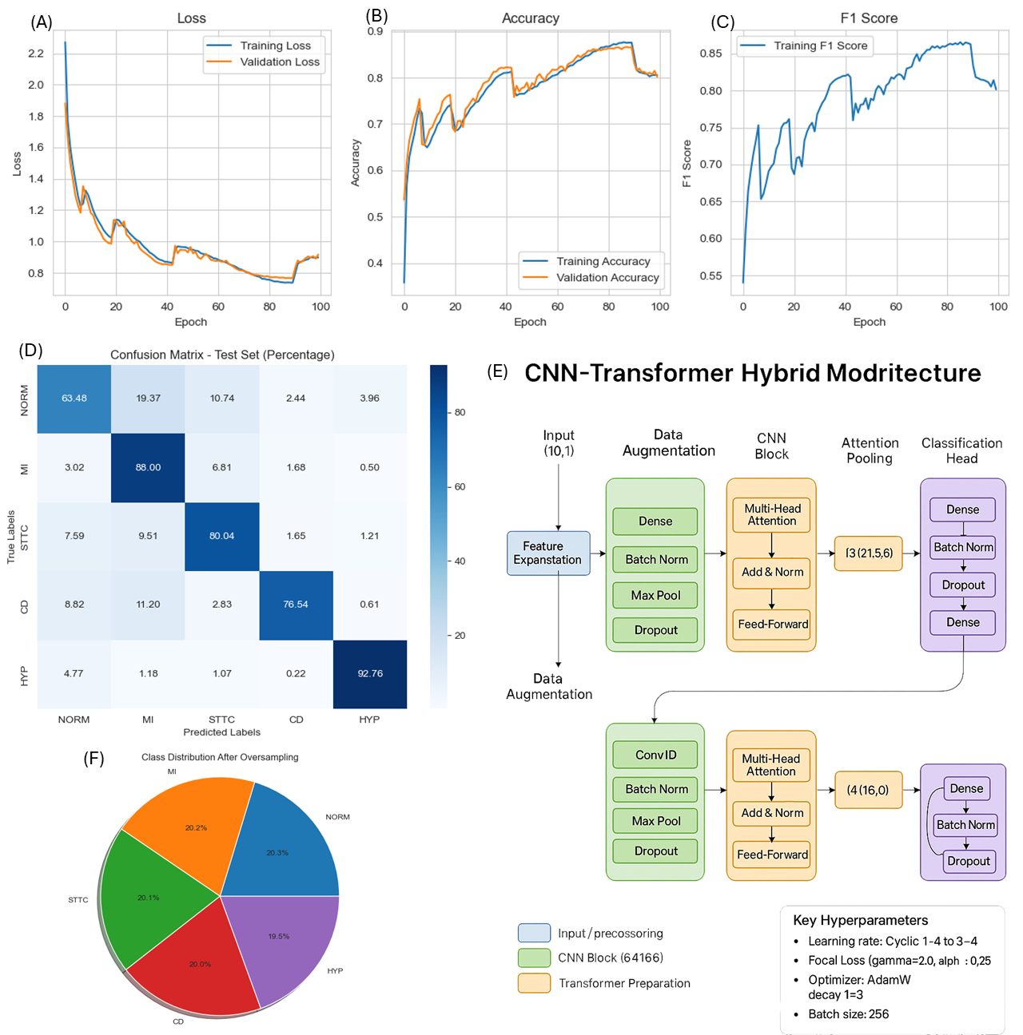
Results
CVDs Detected by ECG Model
Myocardial Infarction
ST/T Change
Conduction Disturbance
Hypertrophy

Slide 19
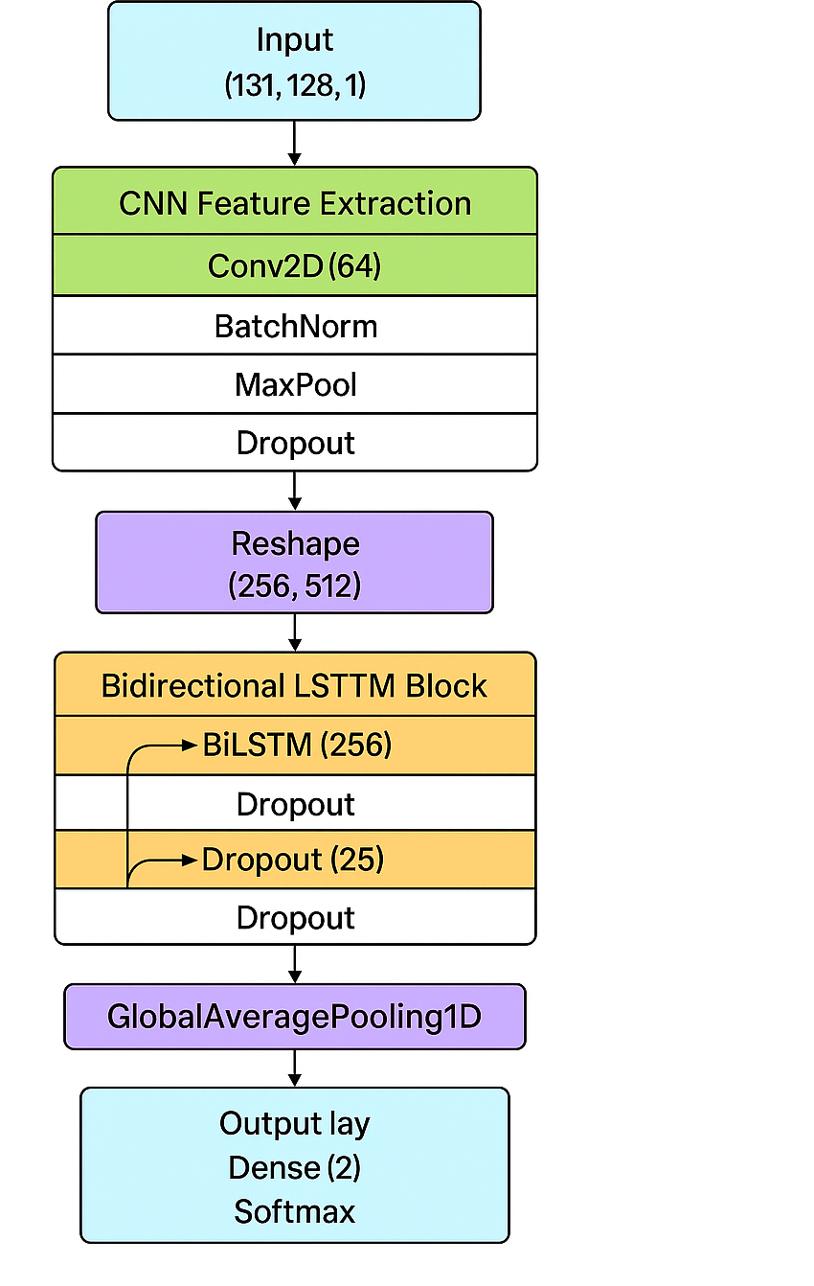
PCG Model: CNN-LSTM
CNN Layers: Four convolutional layers (64 to 512 filters, ReLU activation, batch normalization, dropout) extract spatial features from STFT-based spectrograms, MFCCs, and delta-MFCCs (131 frequency bins, 128 time steps), capturing intricate patterns in PCG signals.
Bidirectional LSTM Layers: Two layers (256 units each) model temporal dependencies in both directions, effectively capturing sequential patterns in cardiac cycles segmented using the Hilbert transform.
Global Average Pooling: Consolidates temporal features into a compact representation, reducing overfitting and preparing features for the final dense layer with softmax activation for classification.
Data Augmentation and Preprocessing: Noise injection, pitch shift, time stretch, time masking, and noise reduction (bandpass filtering, 20-400 Hz) enhance robustness, while SMOTE-Tomek balances the dataset. Cyclical learning rate scheduling (0.0001 to 0.001), early stopping (patience=30), checkpointing, and test-time augmentation (TTA) ensure adaptive optimization and high test performance.

Slide 20
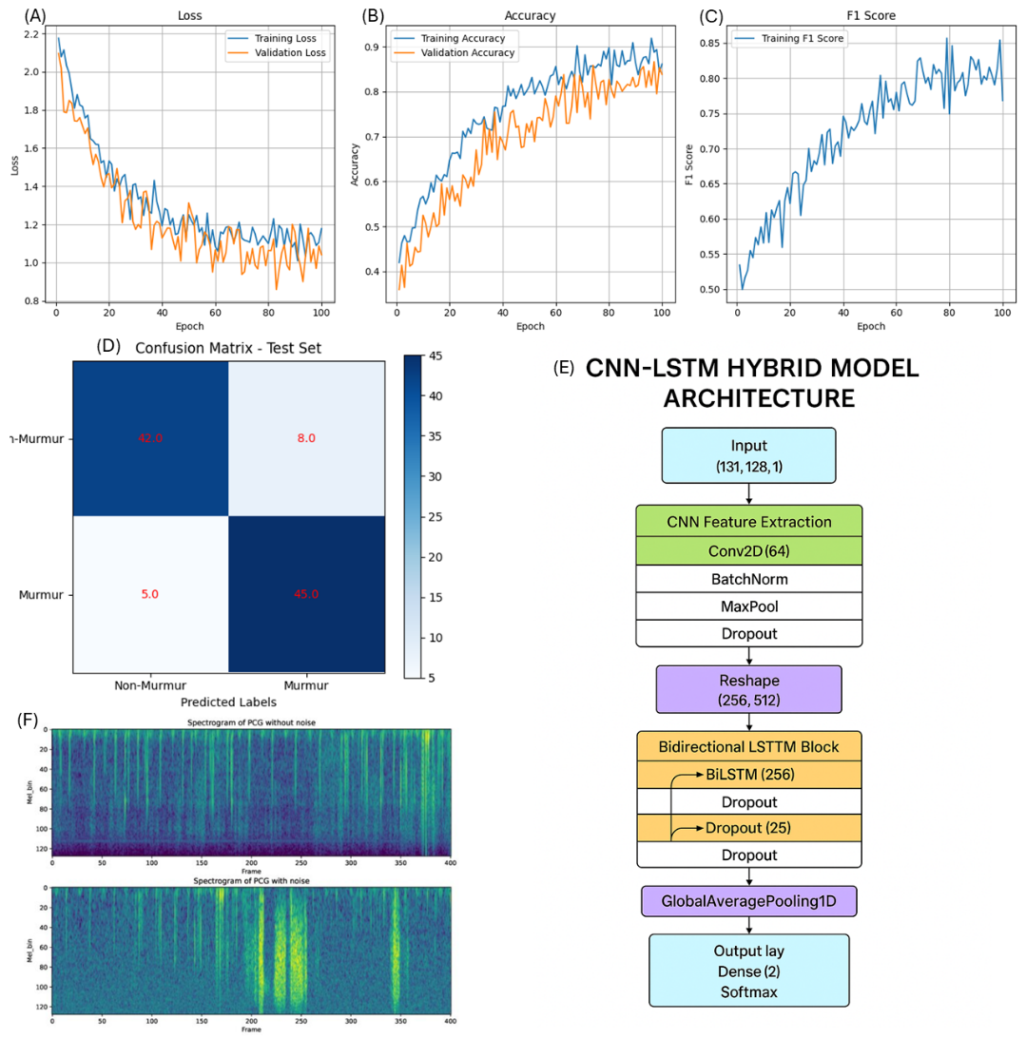
Results

Slide 21
Blood Pressure Estimation Methodology of A. Billa et al.
PPG and Derivatives Dataset: The study utilized PPG signals and their first and second derivatives to create a dataset called PPG+, which captures information related to blood volume changes, atherosclerosis, and vascular elasticity, all of which are linked to blood pressure.
Hilbert–Huang Transform (HHT): PPG signals were processed using the HHT method with ensemble empirical mode decomposition (EEMD) to remove noise and motion artifacts, converting one-dimensional signals into two-dimensional spectrograms for enhanced feature extraction.
Convolutional Neural Network (CNN): The PPG+ dataset was input into CNN models, particularly AlexNet, to classify blood pressure levels (normotension, prehypertension, hypertension), achieving high accuracy, with an F1 score of 98.90% for normotension vs. hypertension.
Improved Accuracy with Derivatives: Including PPG derivatives in the dataset improved prediction accuracy compared to using PPG alone, as derivatives provide additional physiological information about blood flow and vessel elasticity, enhancing blood pressure estimation.

Slide 22
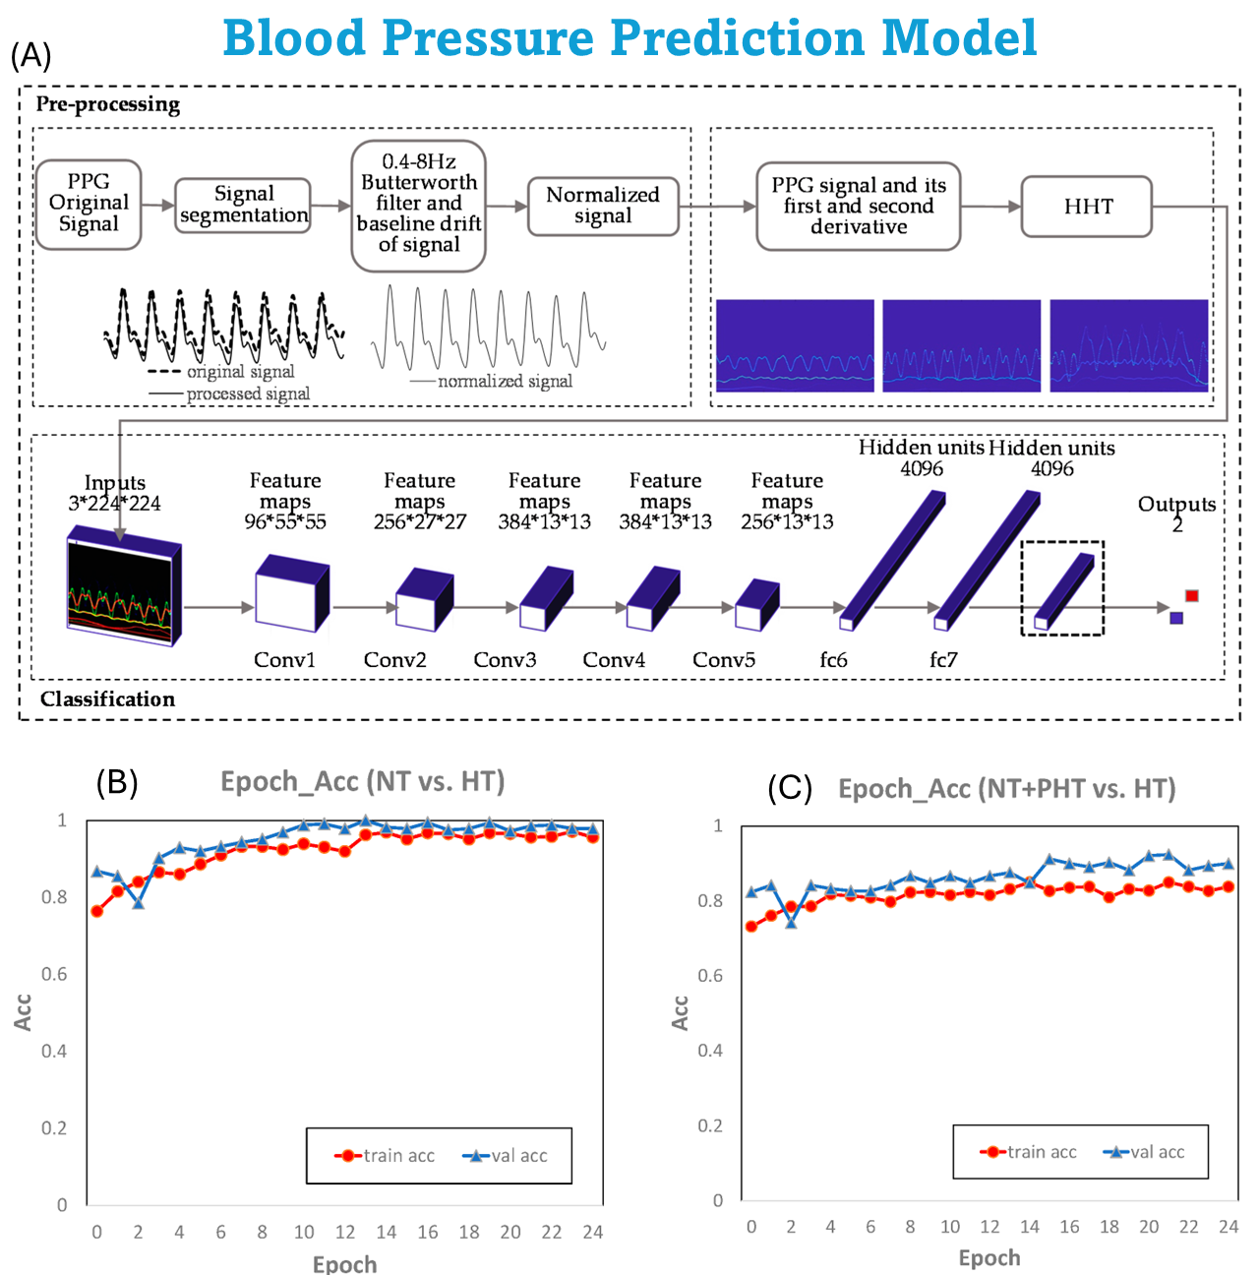
Results

Slide 23
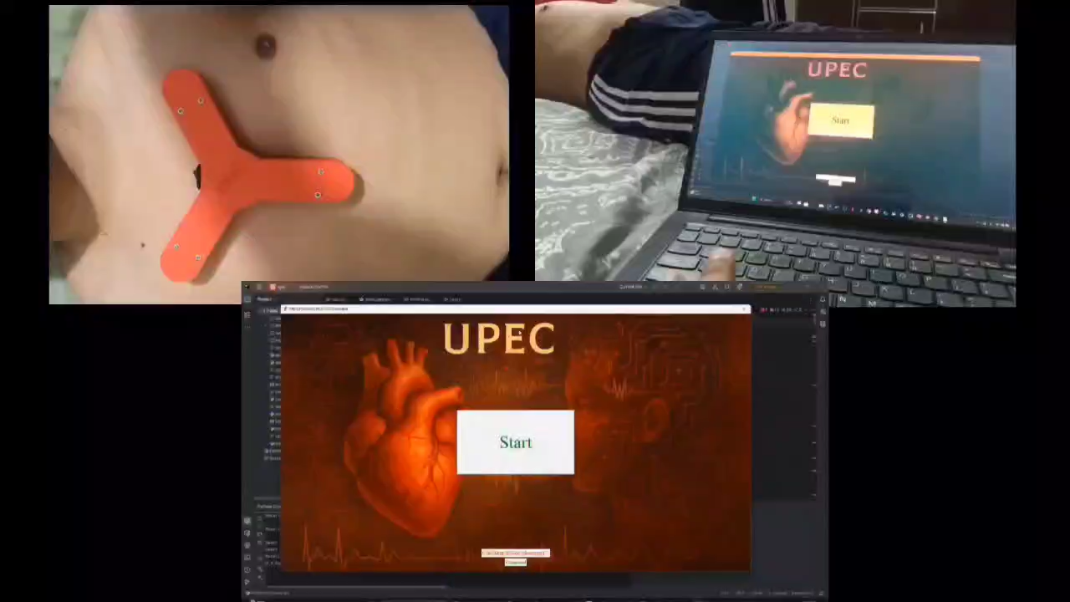
Video demonstration

Slide 24
Conclusion
The UPEC device represents a transformative leap in portable cardiac diagnostics, integrating ECG, PCG, and PPG into a single AI-powered platform. By leveraging advanced deep learning architectures, including CNN-Transformer hybrids for ECG, CNN-LSTM networks for PCG murmur detection, and HHT-enhanced models for cuffless blood pressure monitoring, UPEC delivers clinical-grade accuracy in real-time. Validated on benchmark datasets (PTB-XL, MIMIC) with F1 scores exceeding 93% for critical metrics, it bridges the gap between hospital diagnostics and point-of-care accessibility. With its compact design, multi-modal analysis, and proven detection capabilities for conditions ranging from myocardial infarction to hypertension, UPEC empowers early intervention, remote patient monitoring, and democratized cardiac care worldwide. This innovation redefines portable cardiopulmonary assessment, positioning UPEC as a cornerstone of future preventive healthcare.

Slide 25
Future Scope
Large-Scale Clinical Trials Validate real-world efficacy across diverse populations & settings.
Wearable Form Factor Miniaturize into patches/straps for 24/7 monitoring.
Regulatory Approval (FDA/CE) Secure certifications for clinical deployment.
Low-Resource Adaptation Optimize for telehealth & community health workers.

Slide 26
References
[1] Rai, H.M., Chatterjee, K. Hybrid CNN-LSTM deep learning model and ensemble technique for automatic detection of myocardial infarction using big ECG data. Appl Intell 52, 5366–5384 (2022). https://doi.org/10.1007/s10489-021-02696-6
[2] Obeidat, Y., Alqudah, A.M. (2021). A hybrid lightweight 1D CNN-LSTM architecture for automated ECG beat-wise classification. Traitement du Signal, Vol. 38, No. 5, pp. 1281-1291. https://doi.org/10.18280/ts.380503
[3] R. M. Al-Tam et al., "A Hybrid Framework of Transformer Encoder and Residential Conventional for Cardiovascular Disease Recognition Using Heart Sounds," in IEEE Access, vol. 12, pp. 123099-123113, 2024, https://doi.org/10.1109/ACCESS.2024.3451660
[4] Mastoi, Qurat-ul-ain, Teh Ying Wah, and Ram Gopal Raj. 2019. "Reservoir Computing Based Echo State Networks for Ventricular Heart Beat Classification" Applied Sciences 9, no. 4: 702. https://doi.org/10.3390/app9040702
[5] J. Lin, R. Fu, X. Zhong, P. Yu, G. Tan, W. Li, H. Zhang, Y. Li, L. Zhou, and C. Ning, "Wearable sensors and devices for real-time cardiovascular disease monitoring," Cell Reports Physical Science, vol. 2, no. 8, p. 100541, 2021, https://doi.org/10.1016/j.xcrp.2021.100541
[6] S. K. Nayak et al., "Development of a simultaneous acquisition system for ECG, PCG and body temperature signals," 2015 Annual IEEE India Conference (INDICON), New Delhi, India, 2015, pp. 1-6, https://doi.org/10.1109/INDICON.2015.7443633.

Slide 27
Thank you
Any Questions ?

